Slide 1

Introduction to Git/GitHub
Ignition Hacks 2021
Andrew Shao

Slide 2

About Me:
Your photo
Grade 11 Student at St. Aloysius. Gonzaga. Secondary
Co-Director of Ignition Hacks
Deep Learning Practitioner, Proficient in TensorFlow, Keras, and PyTorch
Placed 29th in the World on the Kaggle HuBMaP Kidney segmentation challenge
Created a Summer Company program called ShaoBotics, shaobotics.ca
https://www.linkedin.com/in/andrew-shao-7653591b4/
https://github.com/ShaoA182739081729371028392

Slide 3

Content
What is Git?
Installing Git
Git Commands:
Creating Repositories
Reviewing Changes to a Repository
Making Changes to a repository
Branches
Undoing Changes in Git

Slide 4
Installing Git

Slide 5

Installing Git
Installing Git on MacOS:
/bin/bash -c "$(curl -fsSL https://raw.githubusercontent.com/Homebrew/install/master/install.sh)"
Brew install git
Installing Git on Windows:
https://git-scm.com/download/win

Slide 6
What is Git?

Slide 7

GitHub/Git: Version Control for your code
Version Control;
Allows you to keep track of changes to your code
Revert Changes and organize your code
Helps with collaboration, as all team members can clearly see any changes needed

Slide 8
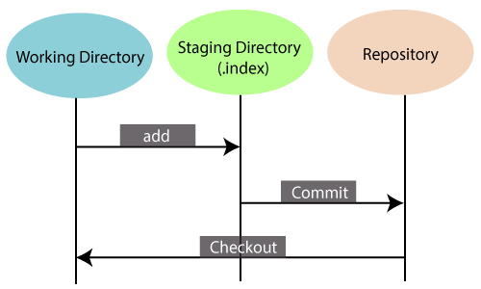
The 3 Stages of Git / GitHub
Working Directory
The Current Directory you are working in
Staging Directory
Where files are hosted before deployed to GitHub
All files are “staged”
Repository
Where code is stored online through Repositories

Slide 9
Part 1: Creating a Git Repo

Slide 10
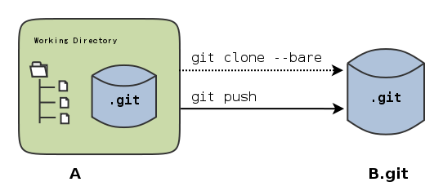
Git/GitHub: Creating Git Repos
Git Init
Create a Git Repo in the current working directory
Git Clone
Clone another person’s repository
Git clone <repository name>
Git Pull
Pull the changes from the Repository

Slide 11
Demonstration: Cloning a Text-Data Git Repository
Git Cloning one of my Public Datasets
https://github.com/ShaoA182739081729371028392/Introduction-to-PyTorch-Ignition-Hacks-2021.git
git clone https://github.com/ShaoA182739081729371028392/Introduction-to-PyTorch-Ignition-Hacks-2021.git

Slide 12
Part 2: Reviewing a Repo’s History

Slide 13
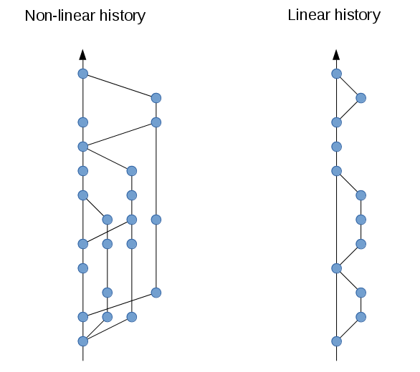
Reviewing History in Git Repos
Git Log
Returns a history of all commits
Includes SHA Codes
Author
Date
Message(Left in Git Commit)
-p: see the actual changes made
Git Status
Check out the current status of the repository
Git Diff
Shows the difference between committed and current.

Slide 14

Demonstration: Reviewing the Past of the Repository
Git log -p
git SHA codes
Reading history

Slide 15
Part 3: Making Changes to a Repo

Slide 16
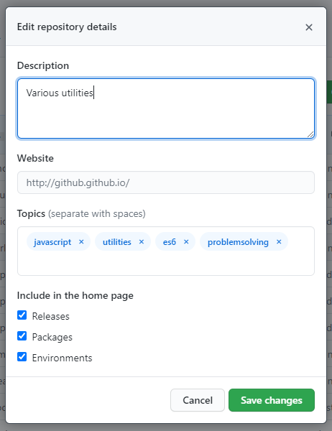
Making Changes to a Repo:
Make the Change to the Files
Git Add
Git commit -m “message”
Git push origin main

Slide 17
Demonstration: Adding Files
Touch file.txt
vim file.txt
Git add .
git commit -m “added file.txt”
Git log -p

Slide 18
Part 4: Merging

Slide 19
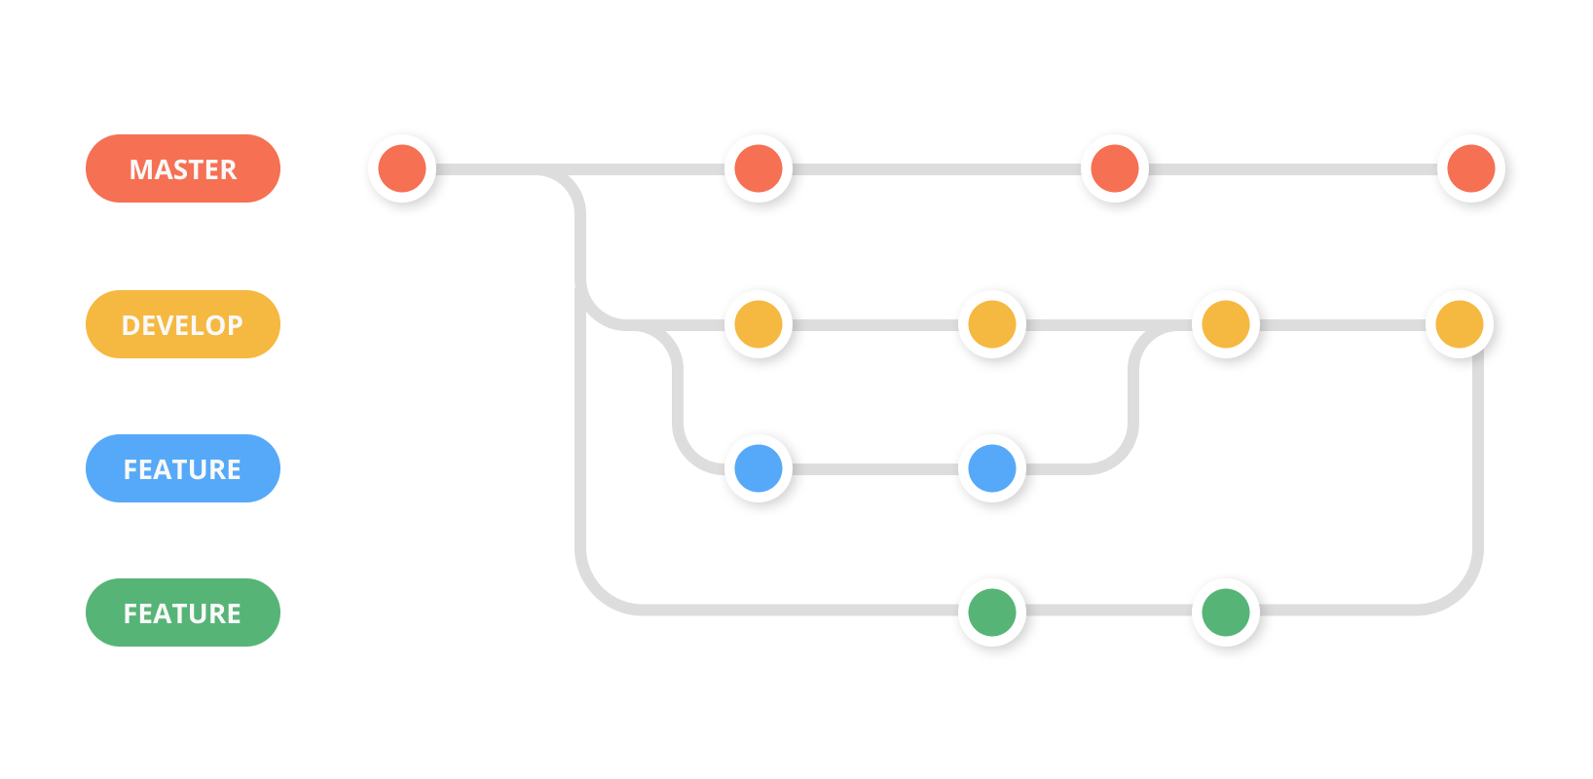
Branching
Branches is another copy of code to change before combining
Allows for temporary changes before combining the code
Easily Revertable if major issues arise
git branch <branch_name>
Creates a new branch
Git checkout <branch_name>
Changes the branch name

Slide 20
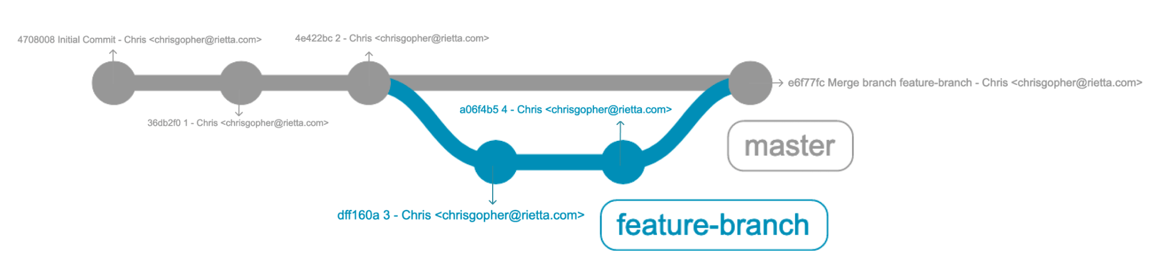
Merging
Merging Branches Combines the changes from different branches
Git Merge <branch_name>
Merges the branch to your current working directory
Merge Conflicts:
When you merge two branches and they are both edited on the same lines
Git cannot choose, so you as the human choose it

Slide 21
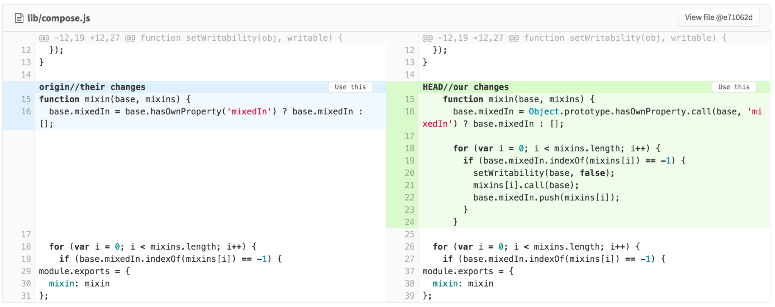
Demonstration: Add branches
Making a branch with git branch <Temporary Branch Name>
Git checkout <Temporary Branch Name>
Merge Conflicts:
Edit the Same line in both branches
Git merge <Branch Name>

Slide 22
Part 5: Deleting/Reverting changes

Slide 23

Reverting Back Changes
Errors in the code, let’s set it back to a previous commit
Git revert <SHA_NAME>
git revert ^
git reset <SHA_NAME>
Git reset --hard <SHA_NAME> (perma delete)
git reset --soft <SHA_NAME> (returns to the staging index)
git reset --mixed <SHA_NAME> (return to the working index)

Slide 24
Demonstration: Push Code to Git/GitHub
Sign up for Git/GitHub , make a public Repository
Git push origin master
Sample Example:
git init
git add README.md
git commit -m "first commit"
git branch -M main
git remote add origin https://github.com/ShaoA182739081729371028392/Introduction-to-PyTorch-Ignition-Hacks-2021.git
git push -u origin main

Slide 25
Thank you!
Q & A Session. Any Questions?

